Slide 1
AI for Workforce
Module 3: What is inside AI?
Notes:
Welcome back to the AI for Workforce program. Today we are discussing Module 3 What is inside AI?

Slide 2
Legal Disclaimers
The Intel® Digital Readiness Programs and Intel® AI for Workforce program are developed by Intel Corporation.
© Intel Corporation. Intel, the Intel logo, and other Intel marks are trademarks of Intel Corporation or its subsidiaries. Other names and brands may be claimed as the property of others. All rights reserved. Program dates and lesson plans are subject to change.
Intel technologies may require enabled hardware, software, or service activation.
No product or component can be absolutely secure.
Results have been estimated or simulated.
Intel does not control or audit third-party data. You should consult other sources to evaluate accuracy.
Your costs and results may vary.

Slide 3
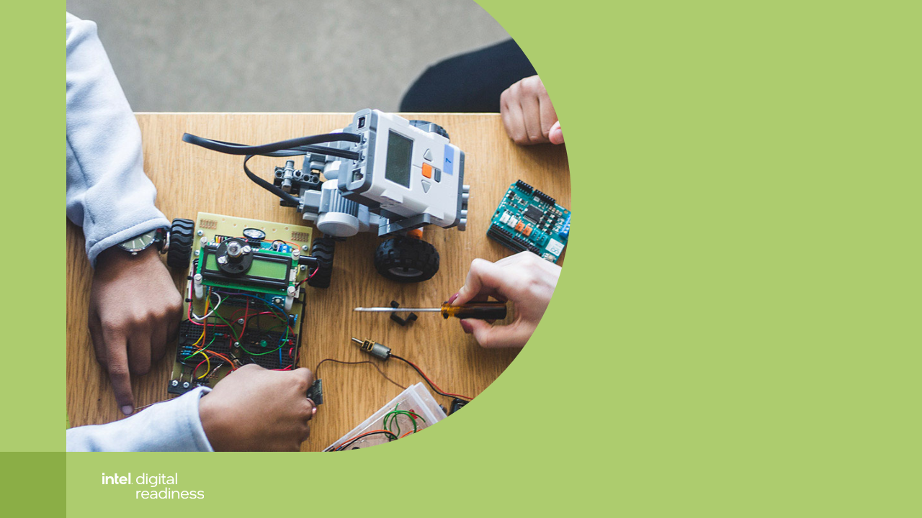
Notes:
Before we proceed with Module 3, let us recap what we have learned in the previous module.
We learnt about features and functions of AI.
We learnt about artificial general intelligence and artificial narrow intelligence.
Further we had a look of various case studies of AI
And we looked into what is AI and what is Not AI.

Slide 4
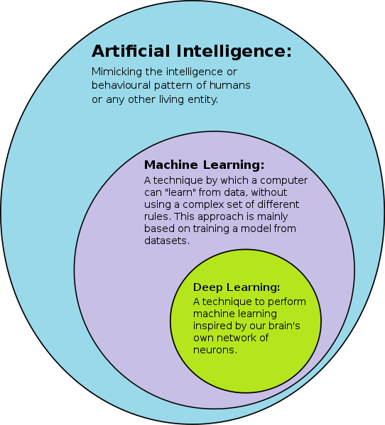
Let’s start by understanding how AI, Machine Learning and Deep Learning fit together
Artificial Intelligence: Mimicking the intelligence or behavior pattern of humans (umbrella term)
Machine Learning: A technique by which a computer can “learn” from data without explicit rules.
Deep Learning: A technique to perform machine learning inspired by our brain’s own network of neurons
[Image of AI-ML-DL] Retrieved on Oct 3, 2021 from https://commons.wikimedia.org/wiki/File:AI-ML-DL.svg
Notes:
Source:
[Image of AI-ML-DL] Retrieved on Oct 3, 2021 from https://commons.wikimedia.org/wiki/File:AI-ML-DL.svg
ML is a subset of AI. Not all AI is ML.
DL is a subset of ML. Not all ML is DL.

Slide 5
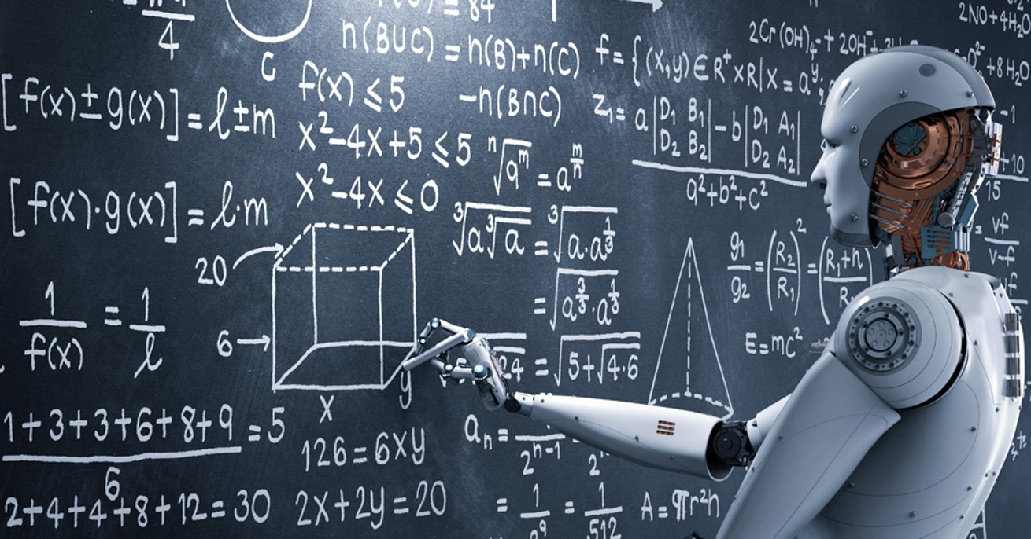
What Happens Inside AI?
[Image of robot on writing on blackboard]. Retrieved October 9, 2020, from https://www.appian.com/blog/artificial-intelligence-going-mainstream-faster-think/
Notes:
AI is not magic. AI is made from logic.
As you can see in the picture, there many mathematical formulas. In the same way, AI makes decision based on a series of mathematical formulas and applies it to a problem.
AI is about making logical decisions, based on the information that it receives.

Slide 6
How AI Works
Computer algorithms make predictions based on existing data. By using statistics, it aims to find a pattern in the massive amount of data, and thus creating a rule to make decisions. The rule is created from the pattern and not from programming it explicitly.
Rules + Data
Classical programming
Answers
Answers + Data
Machine Learning
Rules
Notes:
To say it briefly:
In classical programming, rules are explicitly programmed for the machine.
In machine learning, rules are created from the machine learning algorithm.
Machine learning is the study of computer algorithms that make predictions based on existing data. It aims to find patterns in vast amounts of data by using statistics to create rules for decision making. This is why we say the rule has been created not explicitly programmed.
Source and additional readings:
What is machine learning? Karen Hao.November 17, 2018. https://www.technologyreview.com/2018/11/17/103781/what-is-machine-learning-we-drew-you-another-flowchart/
Machine Learning. Wikipedia. https://en.wikipedia.org/wiki/Machine_learning

Slide 7
Machine learning (ML) is an important subsection of AI and will be studied in detail in the further weeks.
However, for now let us look at some broad distinctions in ML to understand the working of AI.

Slide 8
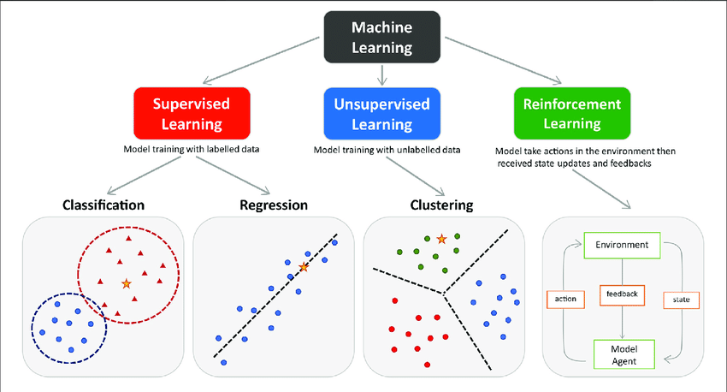
Types of Machine Learning Models
AI Models are broadly classified intro three types:
Supervised Learning
Unsupervised Learning
Reinforcement learning
Notes:
Citation: https://www.researchgate.net/publication/354960266/figure/fig1/AS:1075175843983363@1633353305883/The-main-types-of-machine-learning-Main-approaches-include-classification-and.png
https://www.javatpoint.com/machine-learning-models
Machine learning models are programs that have been taught to recognize patterns in fresh data and anticipate outcomes. These models are modelled as a mathematical function that receives requests in the form of input data, processes that data to create predictions, and then returns an output. These models are first trained using a collection of data, and then an algorithm is given to them so they may analyze the data, find patterns, and learn from the data. These models can be used to forecast the unknown dataset once they have been trained.

Slide 9
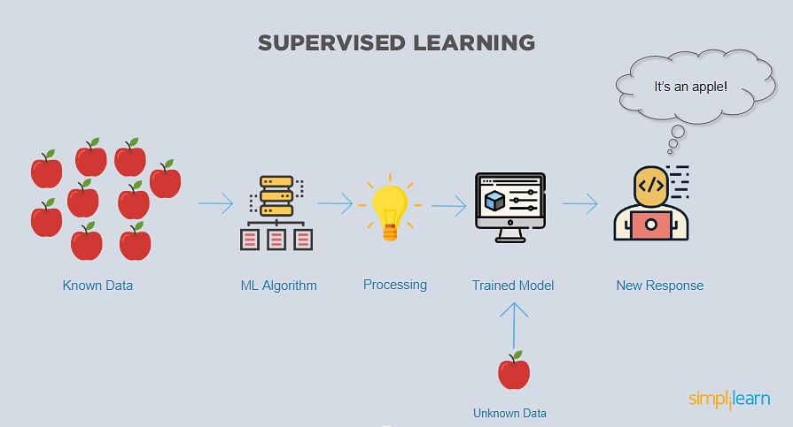
Types of AI Models- Supervised Learning
This model is trained using labeled data.
This method involves providing the model with correct inputs and outputs so that it learns the expected behavior through a mapping function.
Supervised learning has real world applications such as risk assessment, image categorization, fraud detection, spam filtering, etc.
Notes:
https://www.javatpoint.com/supervised-machine-learning
Image: https://www.simplilearn.com/what-is-machine-learning-and-why-it-matters-article
Some of the popular Machine Learning algorithms used in Supervised learning are Linear Regression, Naïve Bayes, Neural Networks, Support Vector Machine, Random Forest Algorithm

Slide 10
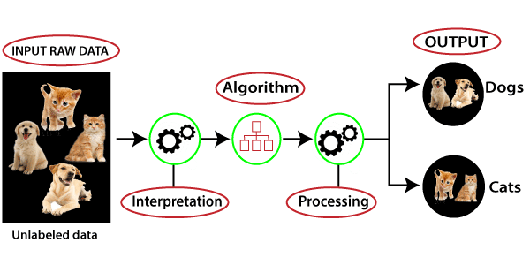
Types of AI Models- Unsupervised Learning
In this models the training set is not labelled.
The model tries to find similarities and patterns in objects and groups them together.
Useful in real world scenarios where the ideal solution to the problem is not known.
Notes:
https://www.javatpoint.com/unsupervised-machine-learning
Examples of Machine Learning algorithms: K-Means Clustering, Principal Component Analysis and Hierarchical Clustering.

Slide 11
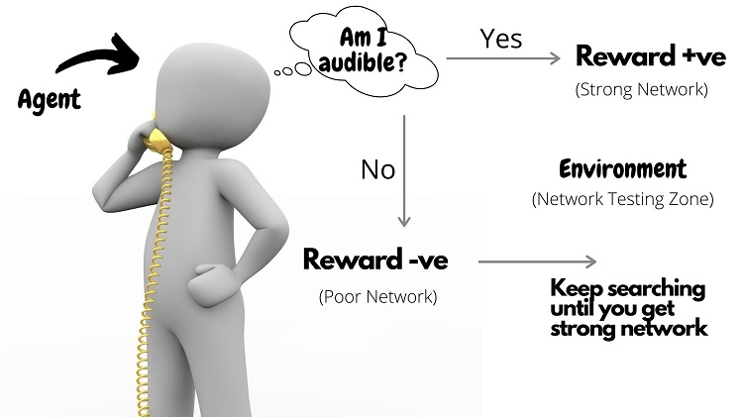
Types of AI Models- Reinforcement Learning
Reinforcement learning uses feedback-based algorithms, where it observes each output from the algorithm to improve itself.
One major example includes robot house cleaners. These robots initially bump lightly into walls and slowly build a map of the house with all these learnings.
Notes:
https://www.javatpoint.com/reinforcement-learning
Image: https://tdwi.org/-/media/TDWI/Upside/newsletters/2020/10/101920Moolya1.jpg

Slide 12
For a detailed look into types of ML algorithms refer to the next diagram
[Image of a network of Machine Learning Algorithm]. Retrieved October 9, 2020, from https://towardsdatascience.com/which-machine-learning-model-to-use-db5fdf37f3dd
Notes:
What you are seeing right now is just part of a list of all the AI models out there.
Some of the popular models include:
Decision Tree. (Animation on mouse click)
Linear Regression. (Animation on mouse click)
K-Nearest Neighbor (kNN). (Animation on mouse click)
And, Random Forest. (Animation on mouse click)

Slide 13
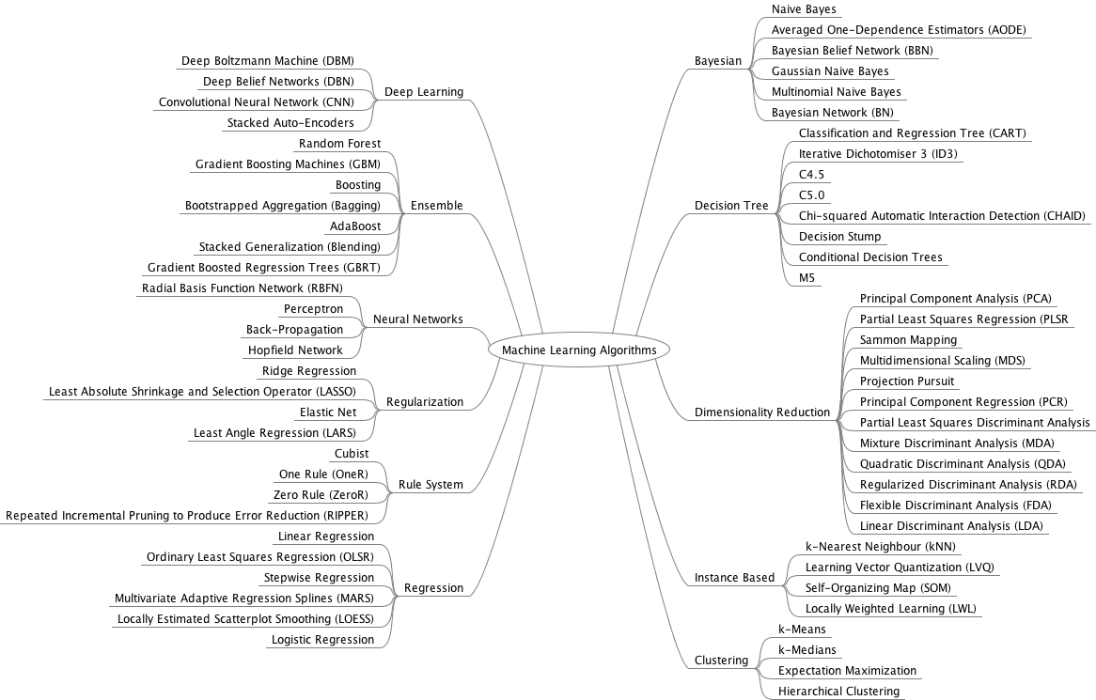

Slide 14
Understanding The Mind of AI

Slide 15
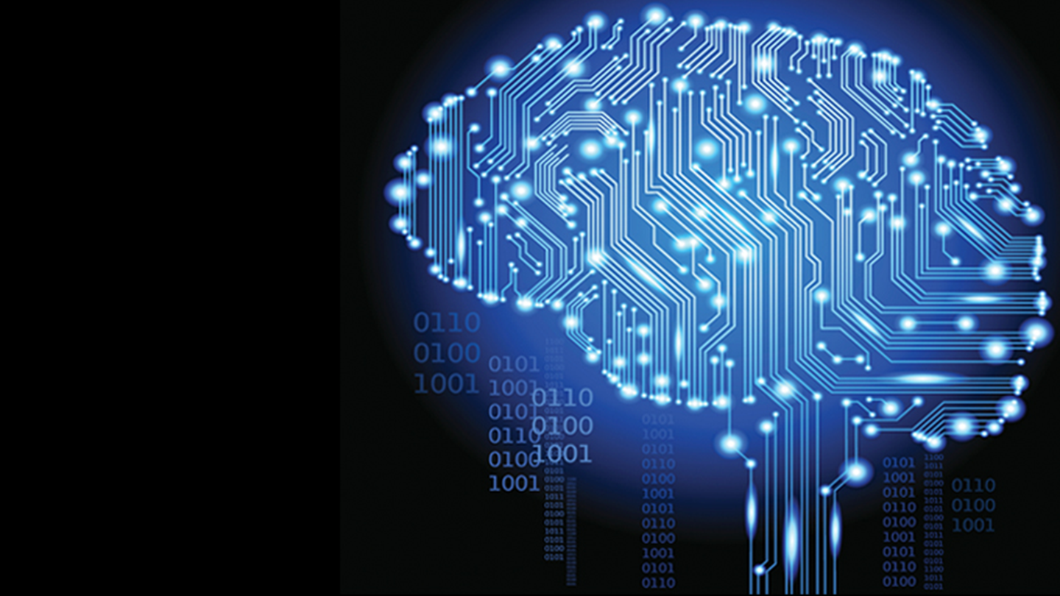
Artificial Intelligence basically helps a machine take its own decisions, but How?
Let us understand how AI analyzes a situation and makes a decision.
Following is the process followed by AI to decide whether a boy can go to a park or not.
Notes:
What you are seeing right now is just part of a list of all the AI models out there.
For this lesson, we will just learn one model. We will learn a very simple model call Perceptron.
Can you find where is the perceptron in Figure 1?
Note to Facilitator: Inside the table, it is on the left, under Neural Networks.
(There is animation for this slide.)
Image : https://www.vectorstock.com/royalty-free-vector/robot-man-thinking-flat-cartoon-vector-17288500

Slide 16


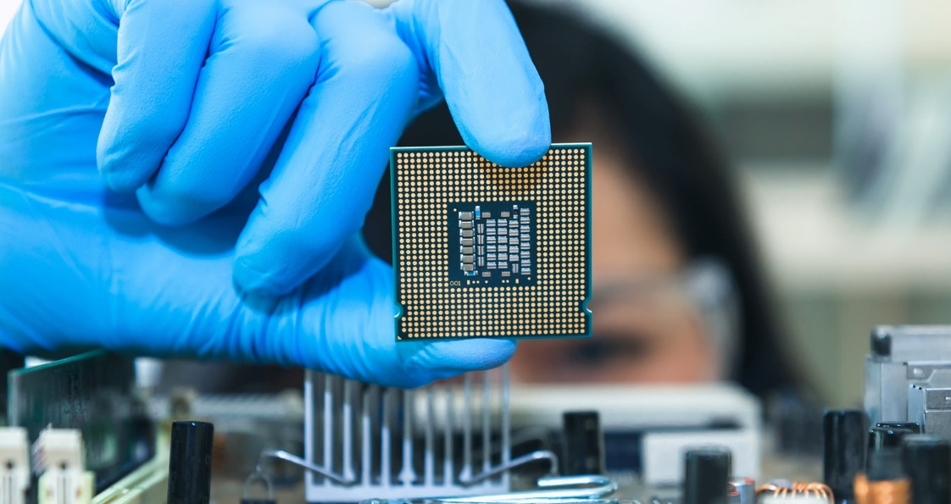



How does AI make a decision?
If you want to go to the park, how do you make your decision?
Do I have a jacket?
Do I have an umbrella?
brgfx[Image].Retrieved October 9, 2020, from https://www.freepik.com/vectors/people
brgfx[Image].Retrieved October 9, 2020, from https://www.freepik.com/vectors/green
brgfx[Image].Retrieved October 9, 2020, from https://www.freepik.com/vectors/background
Is it raining now?
What is the weather forecast for later?
16
Notes:
Let's say you want to go out to the park today. What would be your thought process? What would you consider?
Most of us would want to avoid getting soaked in the rain. These are possible factors that may influence your decision whether to go out. So, the first question that you may ask is, “Should I bring a rain jacket?”
Then, you may also ask, “Should I bring an umbrella?”
Or you may also ask, “What is the weather now?”
And finally, “What will the weather be like, later in the day?”

Slide 17
How does AI make a decision?
3rd
4th
If you want to go to the park, how do you make your decision?
Do I have a jacket?
Do I have an umbrella?
1st
2nd
brgfx[Image].Retrieved October 9, 2020, from https://www.freepik.com/vectors/people
brgfx[Image].Retrieved October 9, 2020, from https://www.freepik.com/vectors/green
brgfx[Image].Retrieved October 9, 2020, from https://www.freepik.com/vectors/background
Is it raining now?
What is the weather forecast for later?
17
17
Notes:
Now, you have the factors that will influence your decision to go out.
But take note, not all factors are equal. Some factors are more important, while some are not.
Let's see which one is more important.
Let us rank them from the most important to the least important
For me, “is it sunny now” is more important than “the weather forecast later”. And “having a jacket” is more important than “having an umbrella. We can put the ranking for this example.
Now let us convert this to perceptron.
(There is animation for this slide.)

Slide 18
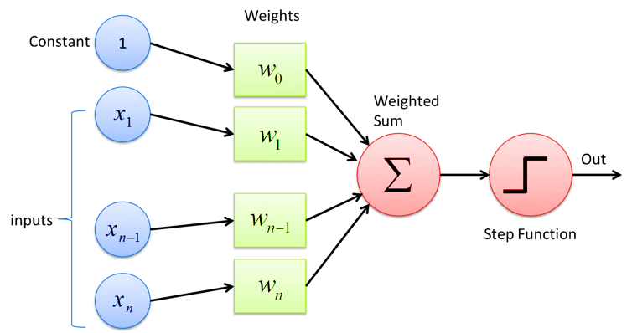
What is a Perceptron?
[Image of perceptron]. Retrieved October 9, 2020, from https://deepai.org/machine-learning-glossary-and-terms/perceptron
18
Notes:
Before we continue with the earlier example, let us learn what is a perceptron.
Perceptron is a simple logic.
With some conditions (we can call these conditions input, reasons, factors), you will perform some simple arithmetic calculation to them, and finally with the output of the calculation, you will determine its results.
(You may also want to write it out on whiteboard/blackboard, telling the students on the process in a step-by-step manner (for slides 10 – 13).)
For more information, please refer to: https://medium.com/@jayeshbahire/perceptron-and-backpropagation-970d752f4e44

Slide 19
What is a Perceptron?
Add all the inputs (factors/conditions/ features) in
[Image of perceptron]. Retrieved October 9, 2020, from https://deepai.org/machine-learning-glossary-and-terms/perceptron
19
Notes:
The very simple model of perceptron is just to add all the inputs.
To start with, let us look at what is “input” in a perceptron.
What are inputs? Inputs can be factors, reasons, conditions, in the decision-making process etc.
In the example just now, the inputs would be factors or conditions such as: do I have a jacket, do I have an umbrella, is it sunny etc.
We will add all the inputs (we will name it X1, X2, X3, and so on)

Slide 20
What is a Perceptron?
Introduce weights for the importance of the respective inputs
[Image of perceptron]. Retrieved October 9, 2020, from https://deepai.org/machine-learning-glossary-and-terms/perceptron
20
Notes:
But each input is not equal.
Some are more important; some are less important. Deciding on the values is based on experience, preference and relevance to the situation.
That is why we introduce the weights here. A factor that is more important will have a larger weight. They are denoted with the symbol W.
Instead of just adding all the input, we now have a weighted input.
Weighted input means the input multiplied with their own weights, just like in the formula.

Slide 21
What is a Perceptron?
Introduce a ‘bias’ to get a ‘Yes’ or ‘No’ decision
[Image of perceptron]. Retrieved October 9, 2020, from https://deepai.org/machine-learning-glossary-and-terms/perceptron
21
Notes:
Now, if we add all the inputs and the weights, the sum will always be a positive value.
For a simple decision, it is either a yes or a no. If we take positive value as yes, and negative value as no, we can never get an answer No as the value is always positive.
Therefore, we must have the possibility of summation to be negative. Therefore, we introduce bias. Bias helps to bring the number down. In this diagram, bias is shown as w0. In our exercise later, we will use WB. Please take note.

Slide 22
What is a Perceptron?
What is the outcome? Positive value = Yes Negative value = No
[Image of perceptron]. Retrieved October 9, 2020, from https://deepai.org/machine-learning-glossary-and-terms/perceptron
22
Notes:
After we get the values (from input and from bias), what do we do with it?
We will determine the outcome based on the summation of both the weighted input and weighted bias. If it is a positive number, then it is a Yes. If it is a negative number, it is a No.
So, we are using zero (0) as a threshold. This is a step function. Any values below the threshold will be assigned low, which correspond to No. Any values above the threshold will be assigned high, which correspond to Yes.

Slide 23
Perceptron Example (go to the park)
X1
W1
X2
W2
Y
W3
X3
WB
W4
X4
B
23
Notes:
Going back to the earlier example, we have four inputs.
So, let’s draw the perceptron with four inputs (from X1 to X4). (Animation on mouse click.)
Next, we have their weights (from W1 to W3). (Animation on mouse click.)
Then, we also have the bias B, with weight WB. (Animation on mouse click.)
Finally, we sum them all up, compare with threshold, and we will get our output. (Animation on mouse click.)
(There is animation for this slide.)

Slide 24
Perceptron Example (go to the park)
Do I have a jacket?
W1
Do I have an umbrella?
W2
Y
W3
Is it sunny now?
WB
W4
What is the weather forecast for later?
B
24
Notes:
Now we will fill in the four inputs with the factors that we have listed out.
•Do I have a jacket?
•Do I have umbrella?
•Is it sunny now?
•What is the weather forecast for later?

Slide 25
Perceptron Example (go to the park)
Do I have a jacket?
3rd
Do I have an umbrella?
4th
Y
1st
Is it sunny now?
WB
2nd
What is the weather forecast for later?
B
25
Notes:
Now we will fill in the importance. But the importance is not very useful in mathematical calculations.
Next, let us assign some numbers to them. At the same time, we will also assign a number for the bias weight (WB).

Slide 26
Perceptron Example (go to the park)
Do I have a jacket?
1.5
Do I have an umbrella?
1.0
Y
3.0
Is it sunny now?
4.0
2.5
What is the weather forecast for later?
B
26
Notes:
How do we know what should be the actual values for the weights? We will not know what are the actual weights. However, we can make some assumptions.
The values for the weights can come from experience. He may have an experience being sunny now would most likely mean a bright day ahead, hence the high importance there.
It can also come from personal preference. A person may judge a particular factor more heavily as compared to another person. For example, she may be more concerned with the weather forecast, hence the higher importance there.
The values for WB are also based on personal preference. If a person is more cautious, he may set the value for WB to be higher, hence his decision would gear towards staying indoors unless he is sure that it would not rain. On another hand, a person who is more daring will have a lower WB, hence he is more likely to go out regardless of the current situation. In this example, we choose 4 as we want to be more cautious.
Therefore, there is no right or wrong answers in coming up with the values for the weights. However, the effects of the values will determine the outcome that the person is going to take, whether to go out or not. That is the reason why everyone comes up with a different decision, even though the situation is the same for everyone.

Slide 27
Perceptron Example (go to the park)
Do I have a jacket?
YES
1
1.5
Do I have an umbrella?
1.0
Y
NO
0
3.0
1
Is it sunny now?
YES
4.0
2.5
1
What is the weather forecast for later?
0
B
NO
Scenario 1
27
Notes:
For this example, let’s say: I have a jacket, I don’t have an umbrella, it is sunny now, and the weather forecast is going to rain.
We can convert the yes and no to numbers 1 and 0. For bias, we will always take 1.

Slide 28
Perceptron Example (go to the park)
Do I have a jacket?
YES
1
1.5
Output = (1 * 1.5 ) + (0 * 1.0) + (1 * 3.0) + (0 * 2.5) – (1 * 4.0)
Output = 0.5
Do I have an umbrella?
1.0
Y
NO
0
3.0
1
Is it sunny now?
YES
4.0
2.5
1
What is the weather forecast for later?
0
B
NO
Scenario 1
28
Notes:
From this calculation, the output is 0.5.
Since this is higher than the threshold (which is zero), the result is I will go out to the park.

Slide 29
Perceptron Example (go to the park)
Do I have a jacket?
NO
0
1.5
Do I have an umbrella?
1.0
Y
YES
1
3.0
0
Is it sunny now?
NO
4.0
2.5
1
What is the weather forecast for later?
1
B
YES
Scenario 2
29
Notes:
Now let us change for another example.
For this example, let’s say: I don’t have a jacket, I have an umbrella, it is not sunny now, and the weather forecast is ok.
We will convert the yes and no to numbers 1 and 0. And similarly, for bias, we will take 1.

Slide 30
Perceptron Example (go to the park)
Do I have a jacket?
NO
1
1.5
Output = (0 * 1.5 ) + (1 * 1.0) + (0 * 3.0) + (1 * 2.5) – (1 * 4.0)
Output = - 0.5
Do I have an umbrella?
1.0
Y
YES
0
3.0
1
Is it sunny now?
NO
4.0
2.5
1
What is the weather forecast for later?
0
B
YES
Scenario 2
30
Notes:
From this calculation, the output is -0.5.
Since this is lower than the threshold (which is zero), the result is I will not go out to the park.

Slide 31
Group Activity
Should I play basketball today?
Should I study for my Math test?
Should I watch Netflix?
Apply the learnings on perceptron for these examples
Notes:
Ok, we have gone through a simple exercise just now. Now is your turn. Please form into 4 groups. You will do something similar, like what I have done just now. Find the factors that are relevant to your problem, figure out their importance and their weights, sum them all up, and finally determine what are your decisions based on the threshold. You have 15 minutes to do all these 3 questions.
(Show slide 17 if they need to refer.)

Slide 32
Group Presentation
Should I play basketball today?
Should I study for my Math test?
Should I watch Netflix?
Apply the learnings on perceptron for these examples
Notes:
Each group will have 3 minutes to present on the three questions.
Group 1, please begin.
(To repeat the same steps for the other groups.)

Slide 33
To illustrate the power of no-code tools for implementing AI, let’s explore Teachable Machine.

Slide 34
Teachable Machine
What is Teachable Machine?
Use case using Teachable Machine

Slide 35

Teachable Machine
What is Teachable Machine?
Teachable Machine is a web-based tool that makes creating machine learning models fast, easy, and accessible to everyone.
Teachable Machine models are real TensorFlow.js models that work anywhere JavaScript runs, so they play nice with tools like Glitch, P5.js, Node.js & more.
Teachable Machine models can be exported to different formats to use elsewhere, like Coral, Arduino & more.
Notes:
Source: Teachable Machine. (n.d.). TeachableMachine. Retrieved October 29, 2021, from https://teachablemachine.withgoogle.com/

Slide 36
Let’s watch a video to understand more about Teachable Machine.

Slide 37

Teachable Machine
What is Teachable Machine?
Notes:
Source: Teachable Machine 2.0: Making AI easier for everyone. (2019, November 7). [Video]. YouTube. https://www.youtube.com/watch?v=T2qQGqZxkD0

Slide 38
Let’s explore Teachable Machine.

Slide 39

Teachable Machine
Step 1: Visit https://teachablemachine.withgoogle.com/
Notes:
After watching the short introduction, it is time for some hands-on. Can you Google search the word “Teachable Machine”?
In this example, we will use the image project. Select image project
We will do a comparison of a red pen and a blue pen.

Slide 40
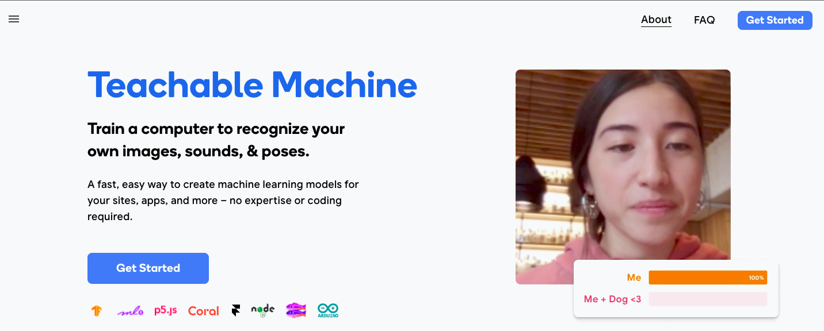
Teachable Machine
Step 2: Click “Get Started”

Slide 41
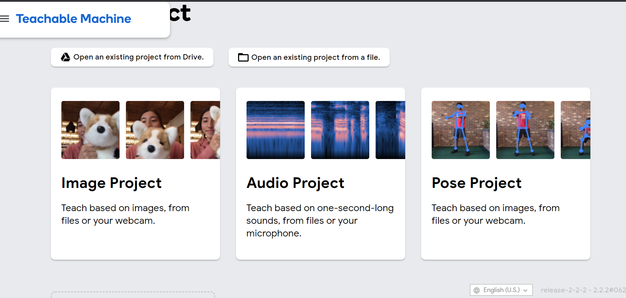
Teachable Machine
Step 3: Select “Image Project”
Notes:
After watching the short introduction, it is time for some hands-on. Can you Google search the word “Teachable Machine”?
In this example, we will use the image project. Select image project
We will do a comparison of a red pen and a blue pen.

Slide 42
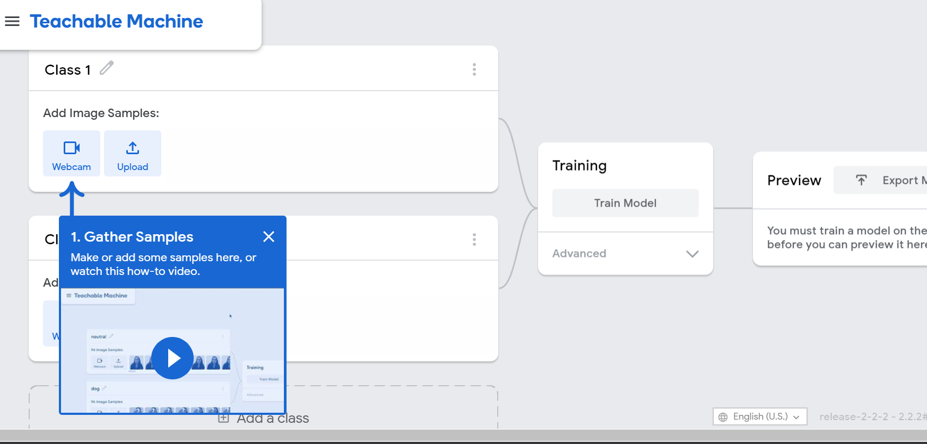
Teachable Machine
Step 4: Rename “Class 1”
Notes:
For Class 1, rename it to Blue Pen.

Slide 43
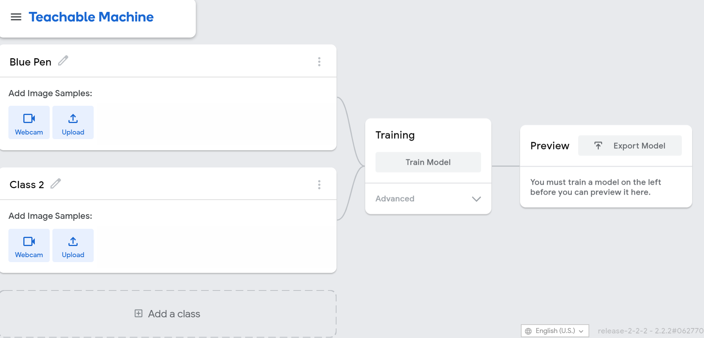
Teachable Machine
Step 5: Select “Webcam”
Notes:
For Add Image Samples, we will be using the webcam to capture the images of the blue pen.

Slide 44
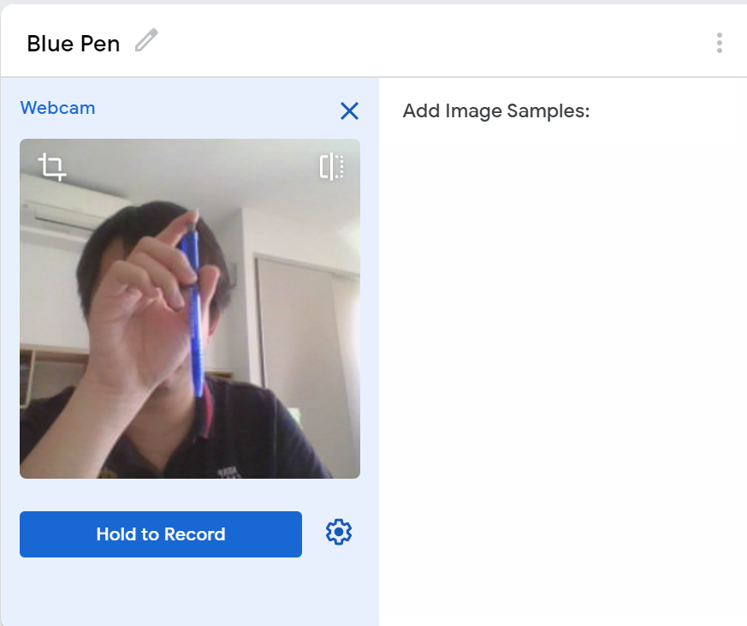
Teachable Machine
Step 6: Click “Hold to record”
Notes:
Click “Hold to record”. It takes multiple images.
For best performance, you should have at least 50 images. The images should be different; therefore, you need to twist and turn the pen around.
After you are done, unclick and remember to close the box (X).

Slide 45
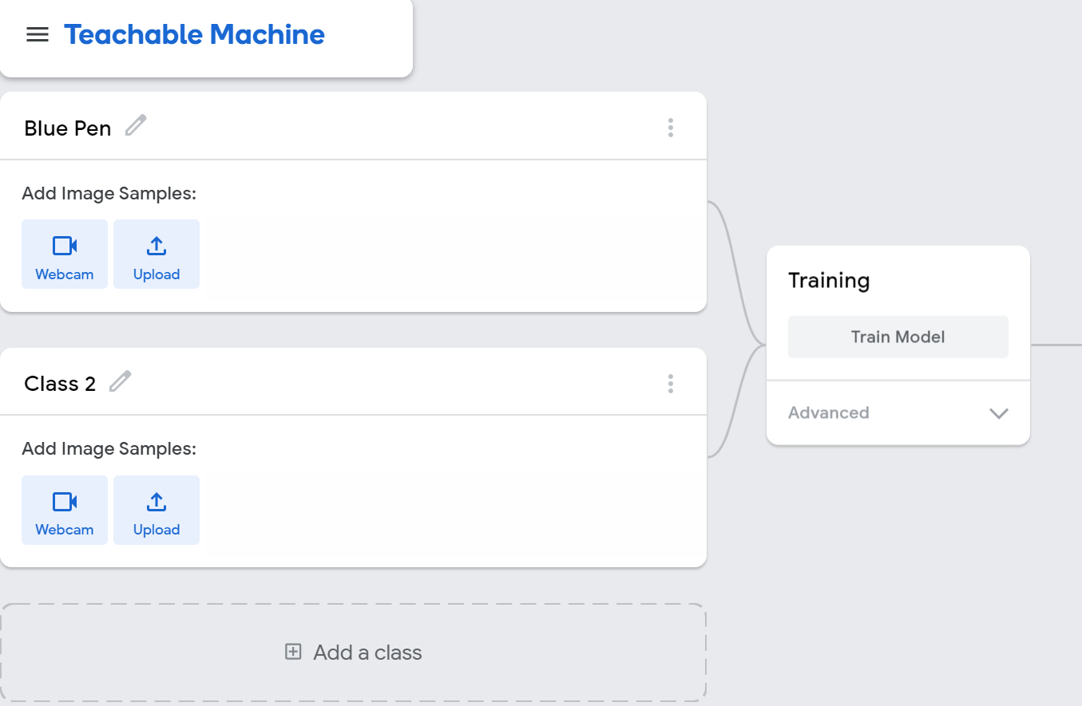
Teachable Machine
Step 7: Repeat steps 2 – 4 for “Class 2”
Notes:
Now, repeat steps 2 to 4, for Class 2. This time, for class 2, let’s rename it to Red Pen. Use the webcam to take the photos of a red pen.

Slide 46
Teachable Machine
Step 8: Repeat steps 2 – 4 for “Add a class”
Notes:
Now, we will repeat the steps 2 to 4, again. This time, it is for the time when there is no pen.
For this, we will take the photo of the background.

Slide 47
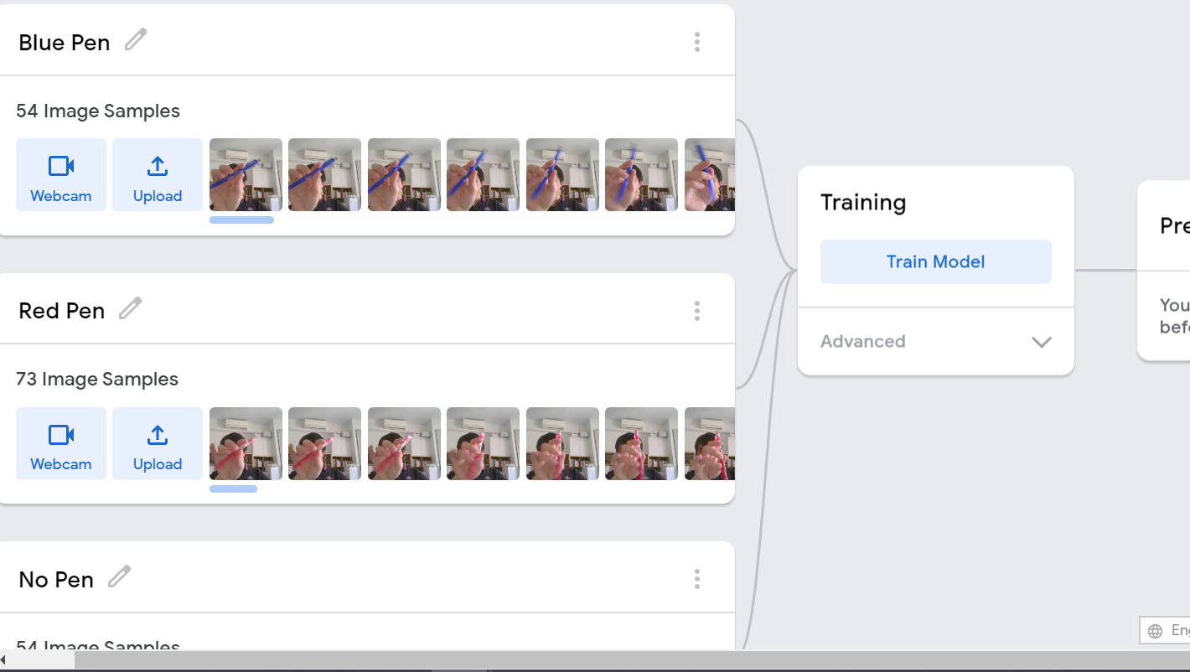
Teachable Machine
Step 9: Click “Train Model”
Notes:
Remember to close the box in webcam.
Now click on “Train model”. You will see “preparing training data”.

Slide 48
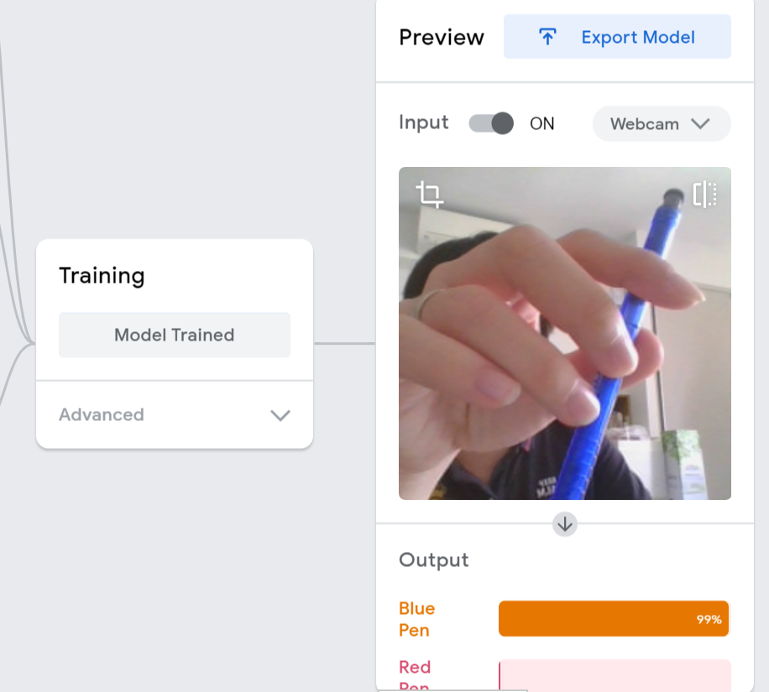
Teachable Machine
Step 10: Test Model using Red and Blue pen
Notes:
After the training is done, you will see the webcam is turn on, where you can preview your model. You can test it out with a red pen or a blue pen.

Slide 49
Activity
Time: 15 minutes
Create a Machine Learning Model using Teachable Machine to perform any one of the task:
Mask vs No-mask
Face Recognition
Phone Models
Stationery
Notes:
Source:
Results may vary. If the results are not satisfactory, students can repeat the experiment again with different image combination.

Slide 50
Teachable Machine
Mask vs no mask
Face recognition
Phone models
Stationery
Explore other groups’ Teachable Machine models
Notes:
Ok, time up. For the next 15 minutes, explore what your friends have created in the other groups.

Slide 51
Reflection
How does AI work?
How does perceptron work?
What is Teachable Machine?
How to create a training model using Teachable Machine
Notes:
Let us recap what we have learnt so far.
Today we have learned how AI works. And there are many ways AI can make decisions. And for that, we learn a basic AI model.
Do you still remember the name of the basic AI model that we have gone through? (Perceptron)
We also learn how to use Teachable Machine to perform everyday tasks. You have learnt that it can detect many things. For example, whether a person is wearing a mask. Another example is to detect if that is a red pen or a blue pen, etc.
You can further explore on your own, on what you can do with Teachable Machine in your daily lives.

Slide 52
Notes:
Thank you for your contribution today. I look forward to the next module with all of you.

